Slide 1
Claude Code Skills
EricWTech

Slide 2


Slide 3
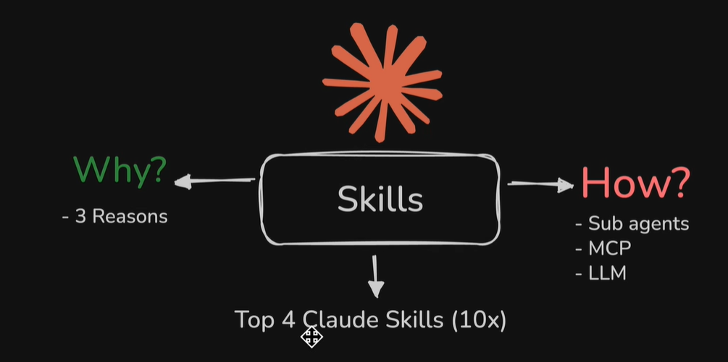

Slide 4
Why use Claude Skills
Specific and Repeatable Tasks: Claude Skills excel at handling routine tasks. For example, once you've defined a specific UI style (typography, colors, etc.), you can create a skill for it. This ensures that the next time you need a front-end design, the AI understands your exact requirements immediately, leading to smoother results with less "hallucination" [01:04].
Context Management: Unlike "Claude Rules" (which act like system prompts passed to every conversation), Claude Skills help save context. The AI automatically selects only the relevant skill for the specific request, preventing it from being bogged down by irrelevant rules or system prompts [01:49].
Easy Collaboration and Reusability: Eric compares skills to Standard Operating Procedures (SOPs). They can be easily shared with coworkers or across different projects as zip files. This allows multiple "sub-agents" to share the same standardized skills, making it much easier to automate and scale complex workflows [02:35].

Slide 5
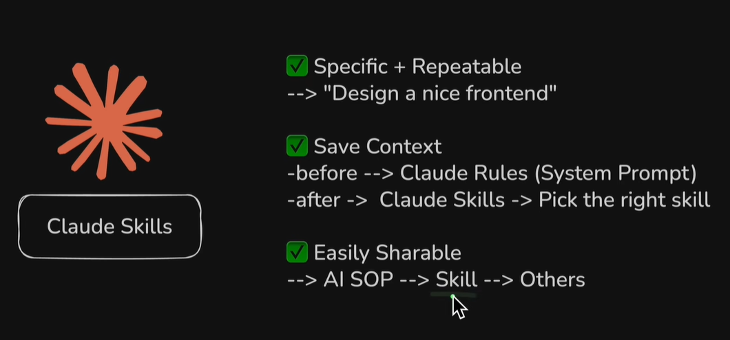

Slide 6
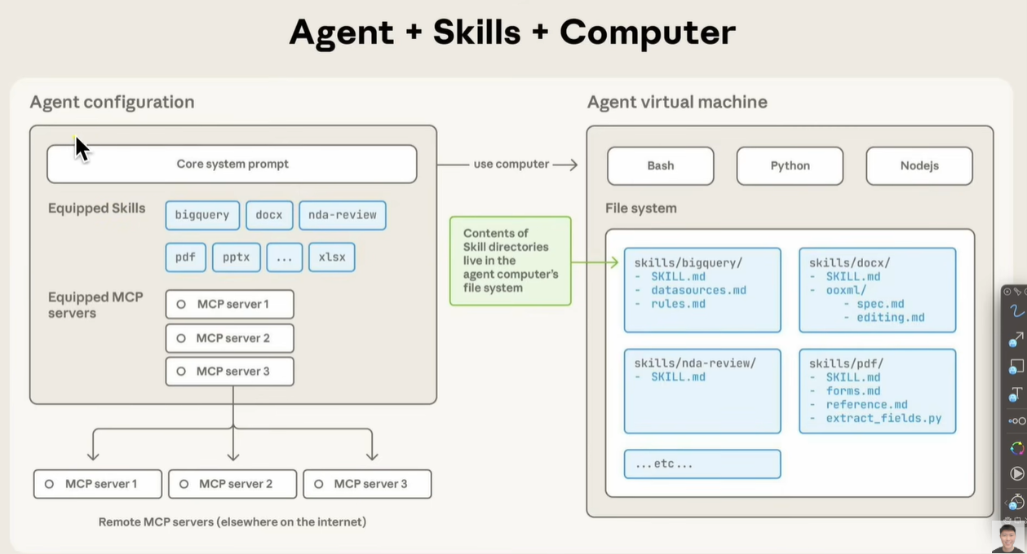

Slide 7
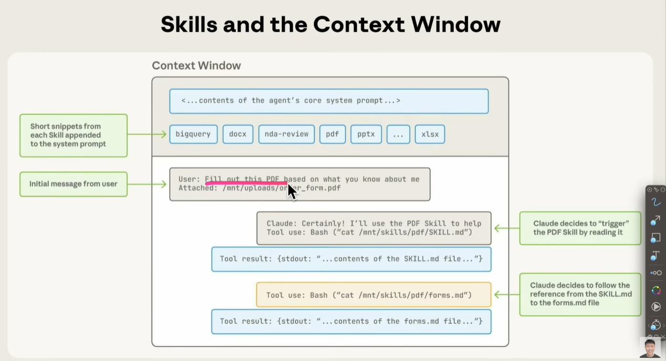

Slide 8
Front end design

Slide 9
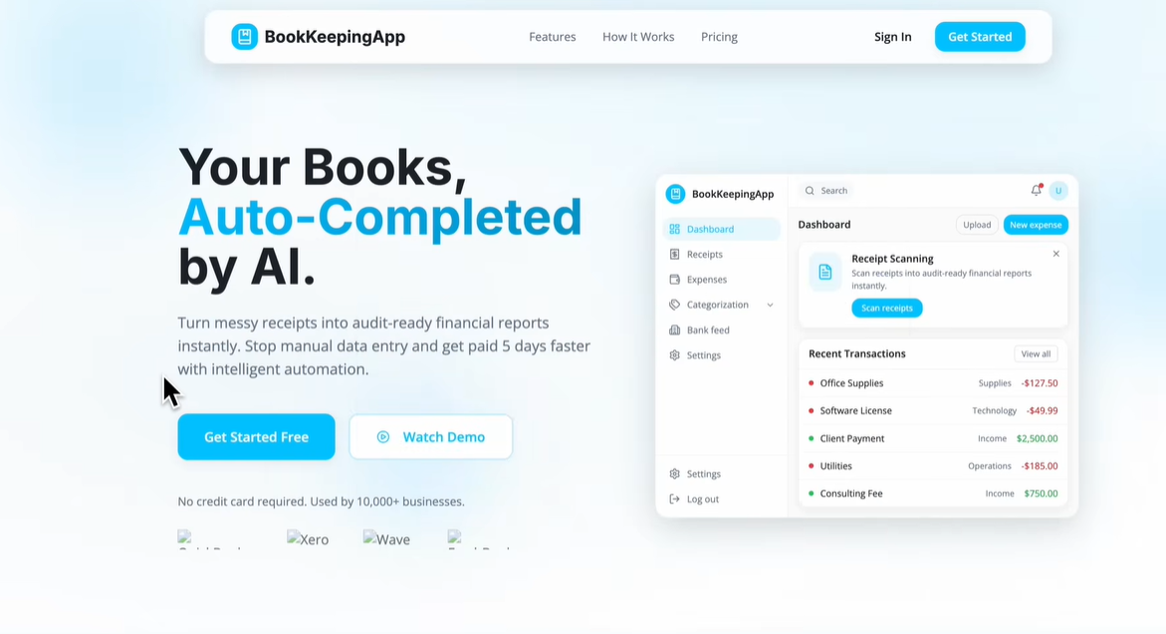

Slide 10
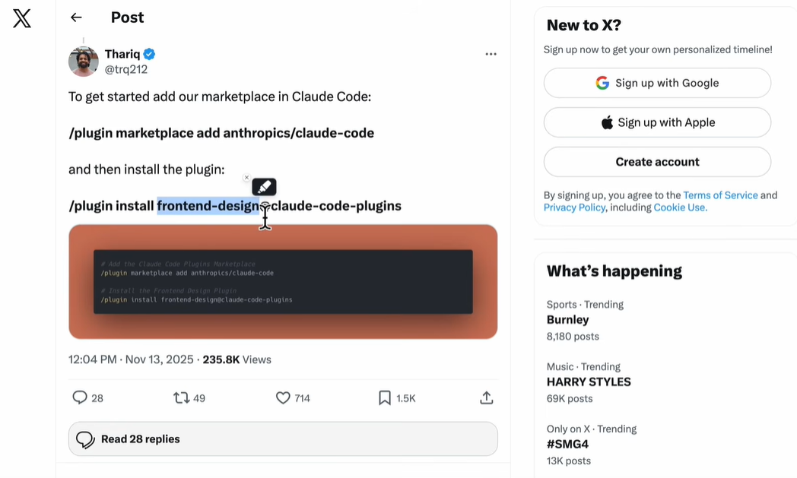

Slide 11
@trq212 Thari Shihipar
A prominent AI engineer working on Claude Code at Anthropic

Slide 12
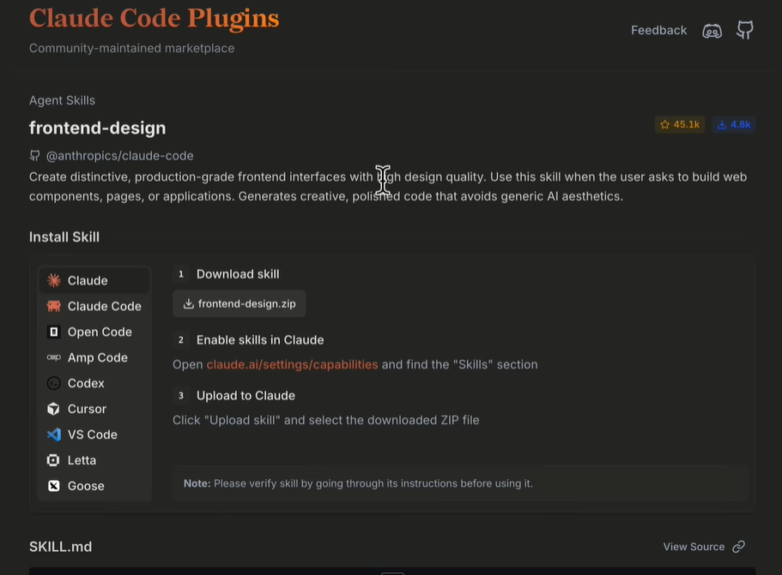

Slide 13
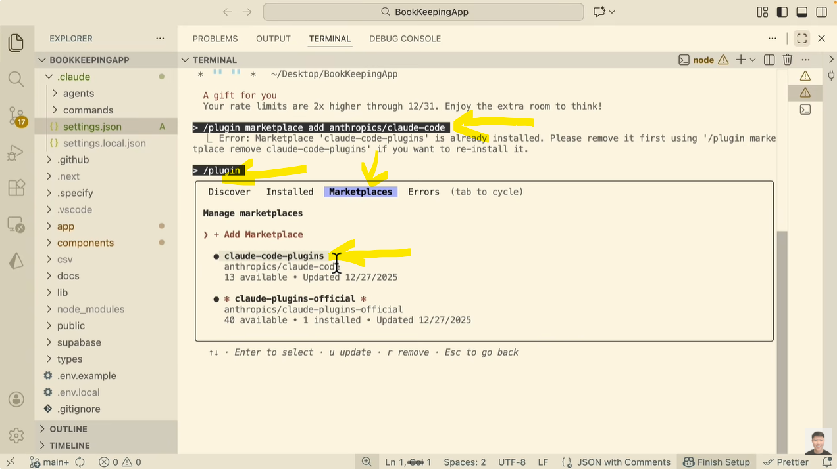

Slide 14
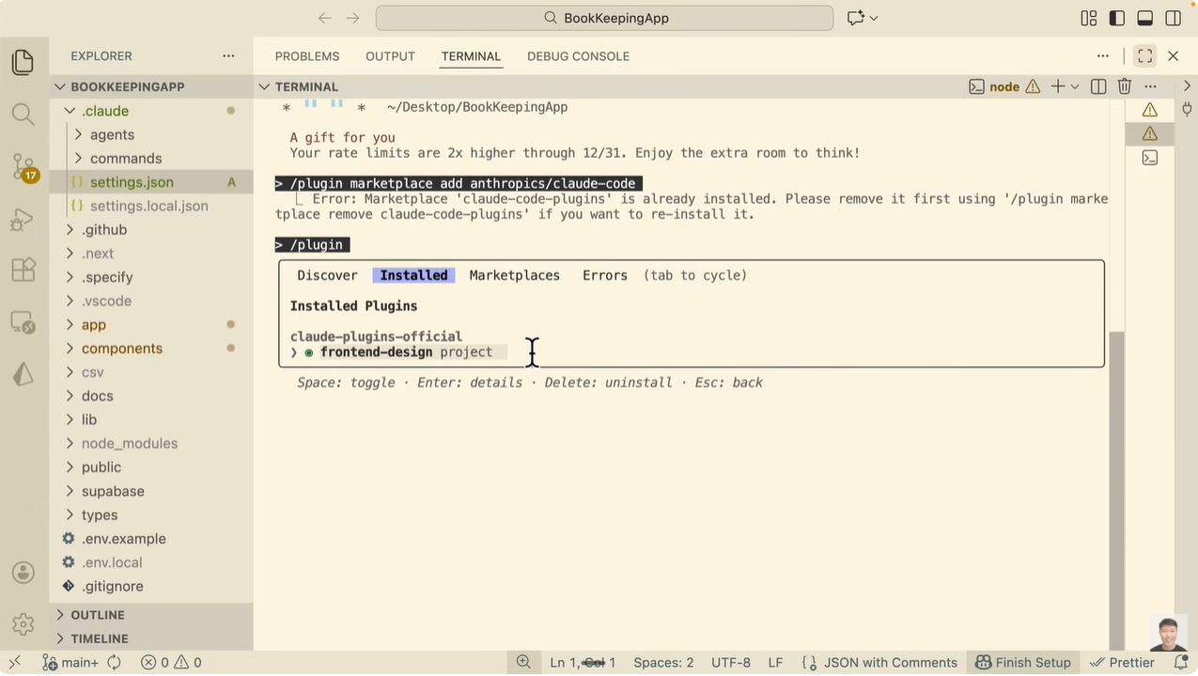

Slide 15
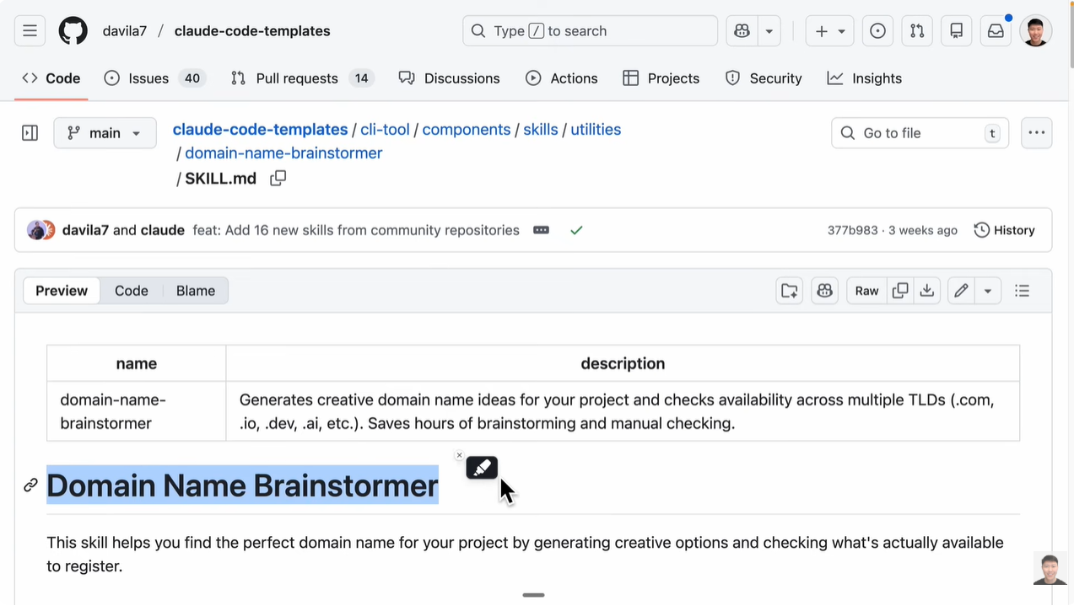

Slide 16
Domain name brainstormer

Slide 17
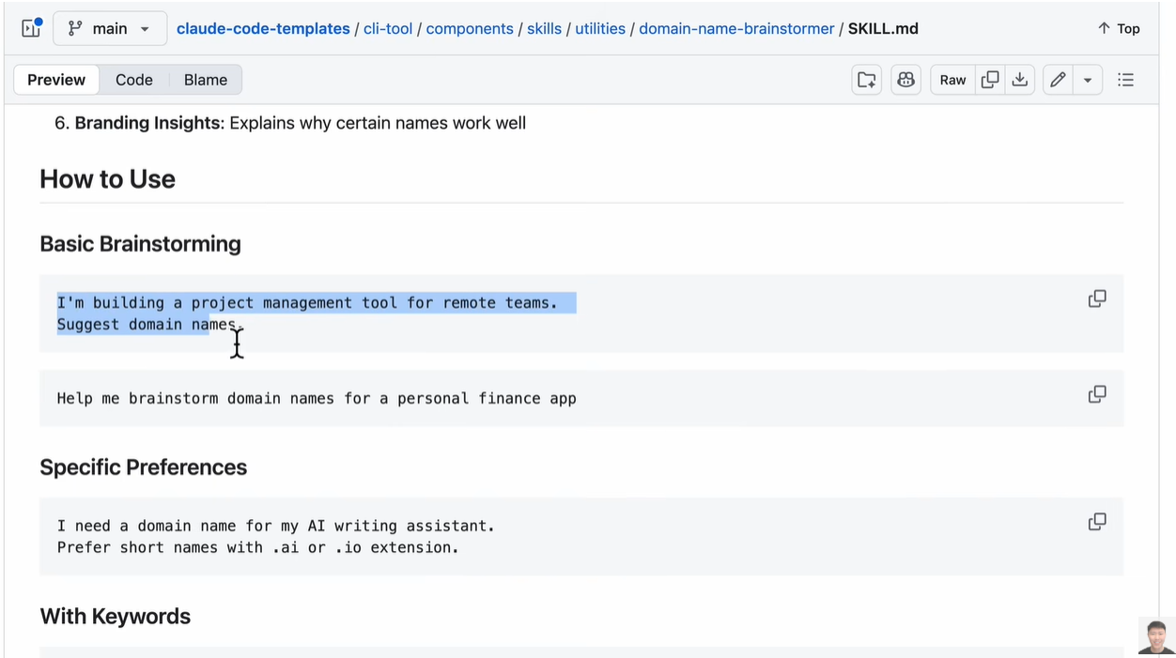

Slide 18
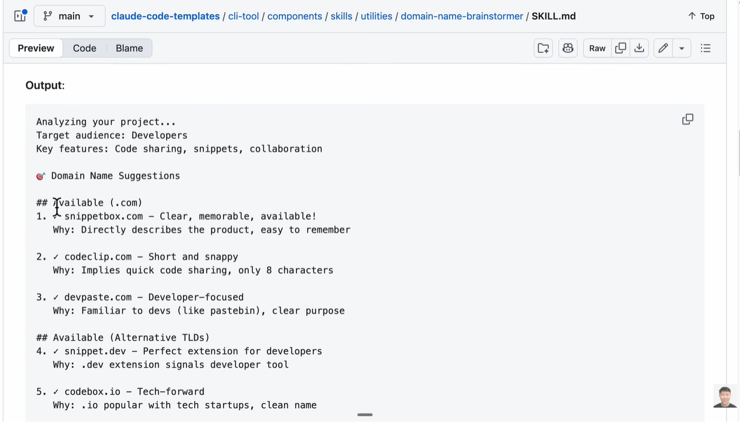
Download domain name brainstormer

Slide 19
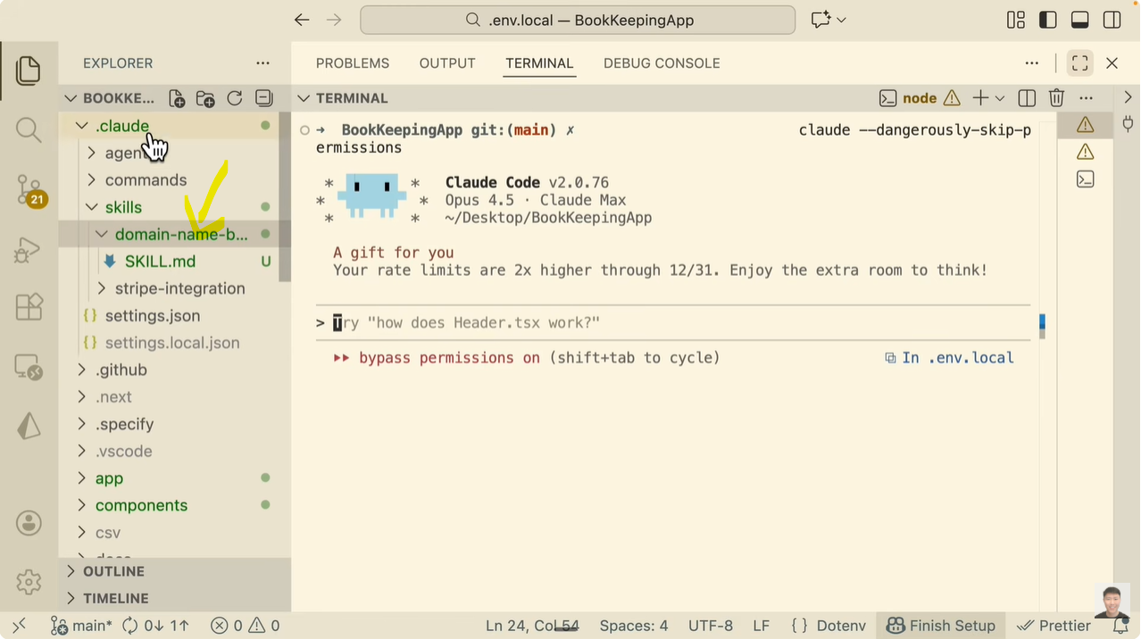

Slide 20
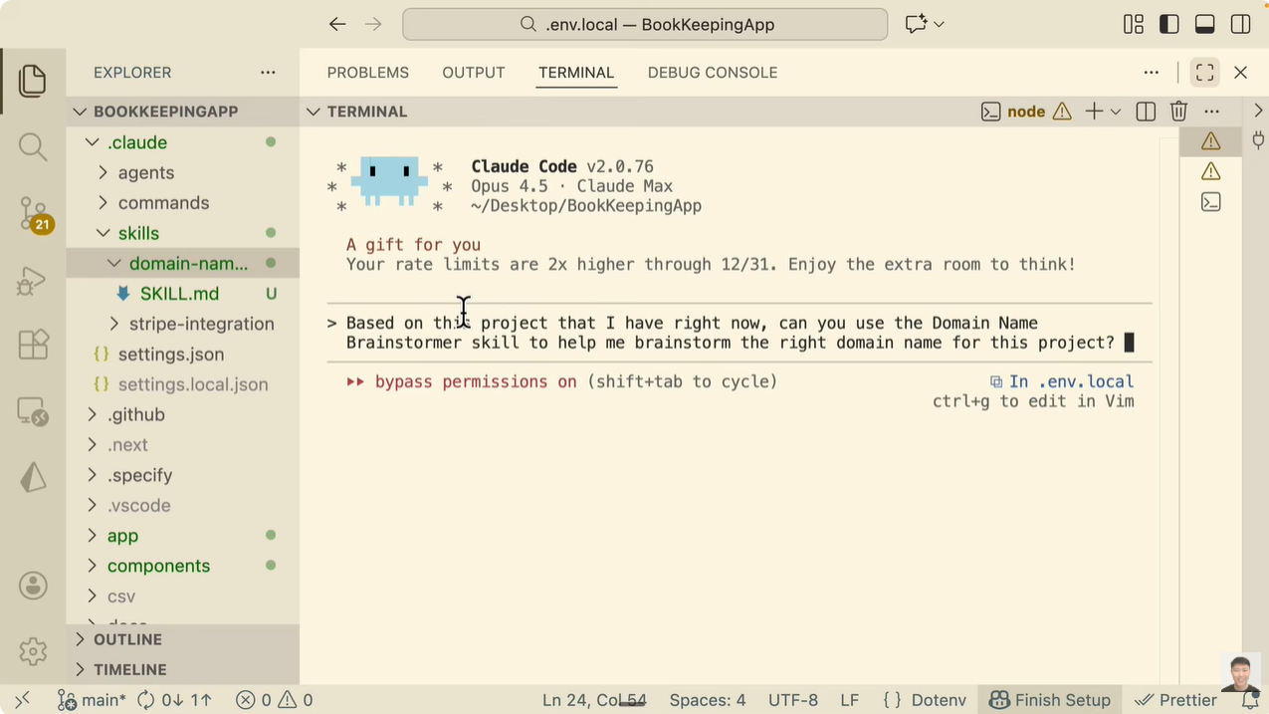

Slide 21
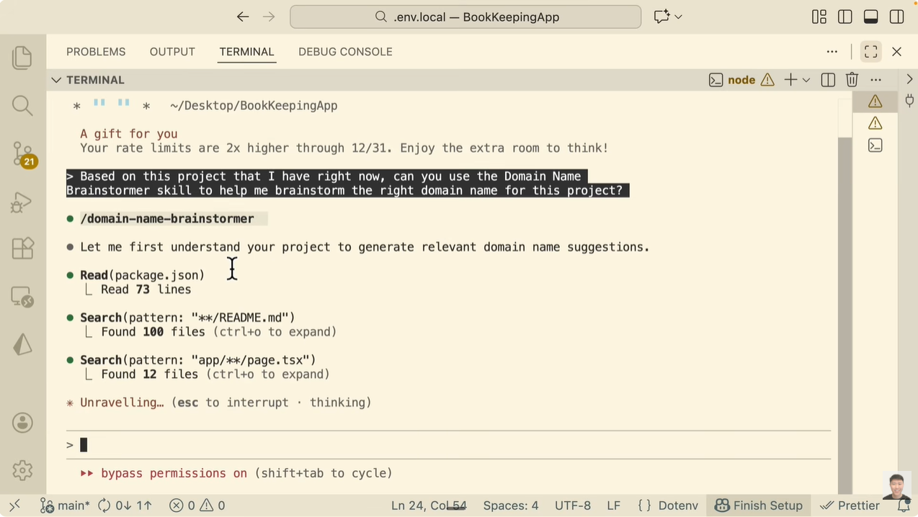

Slide 22
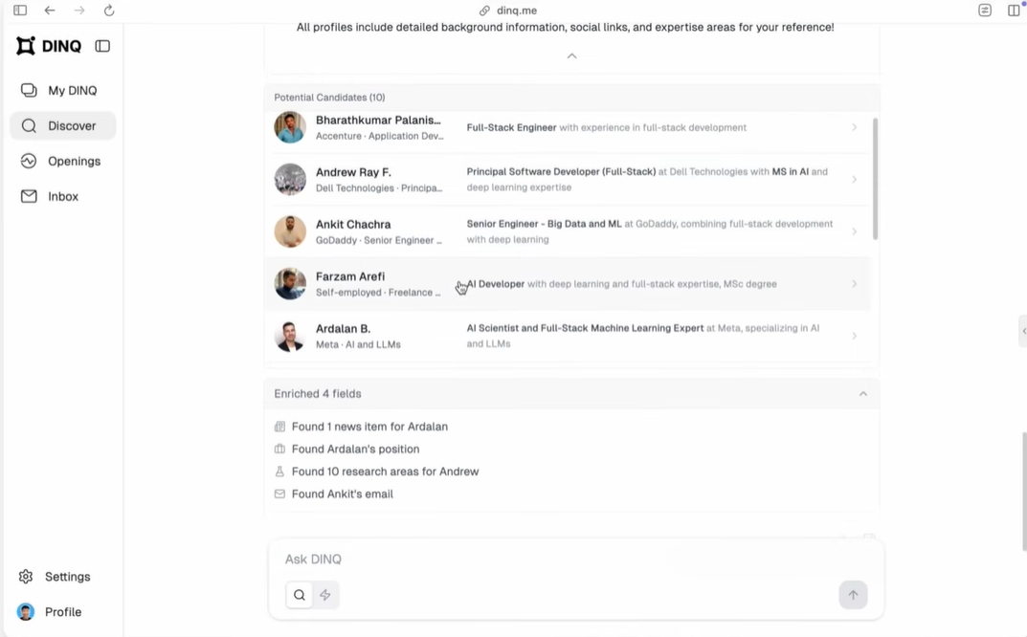

Eric Tech has created an AI Profile tool, called DINQ
Invite code for testing

Slide 23
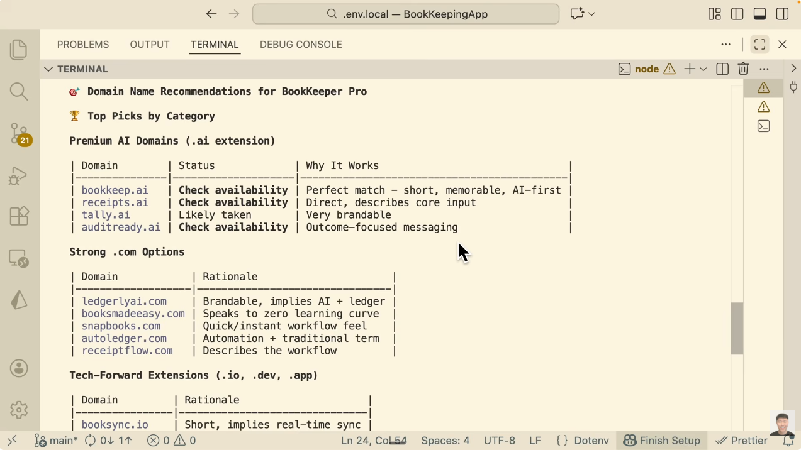

Slide 24
Stripe Integration

Slide 25
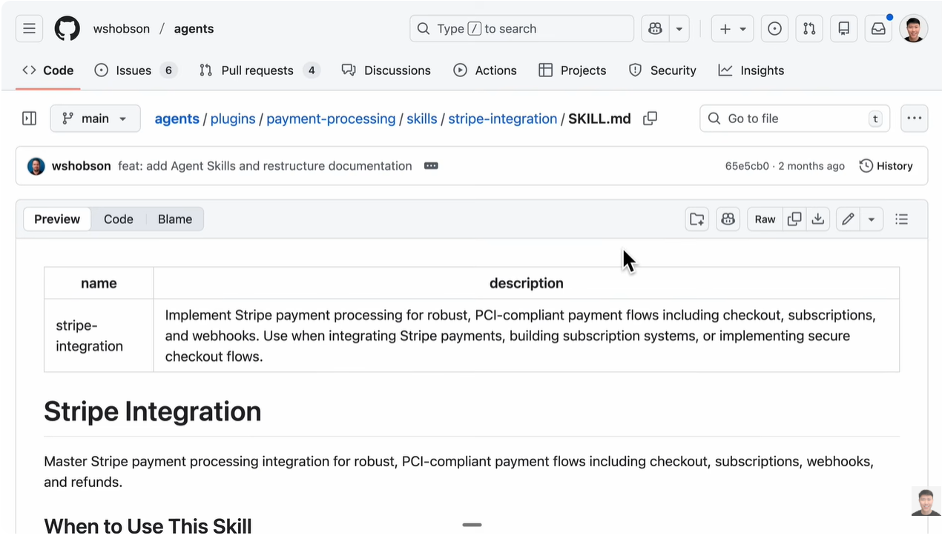
Download this skill

Slide 26
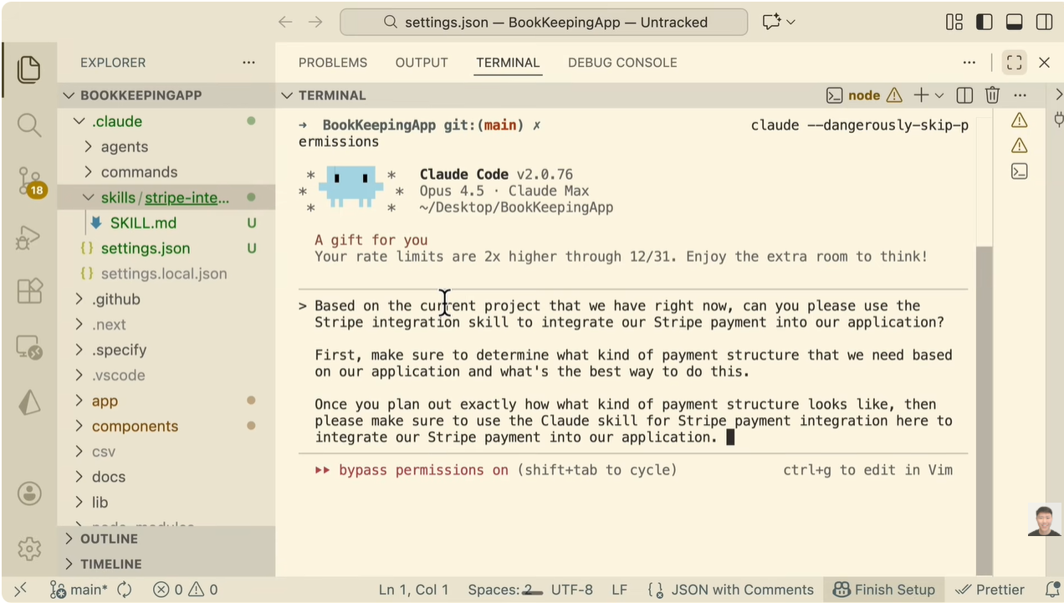

Slide 27
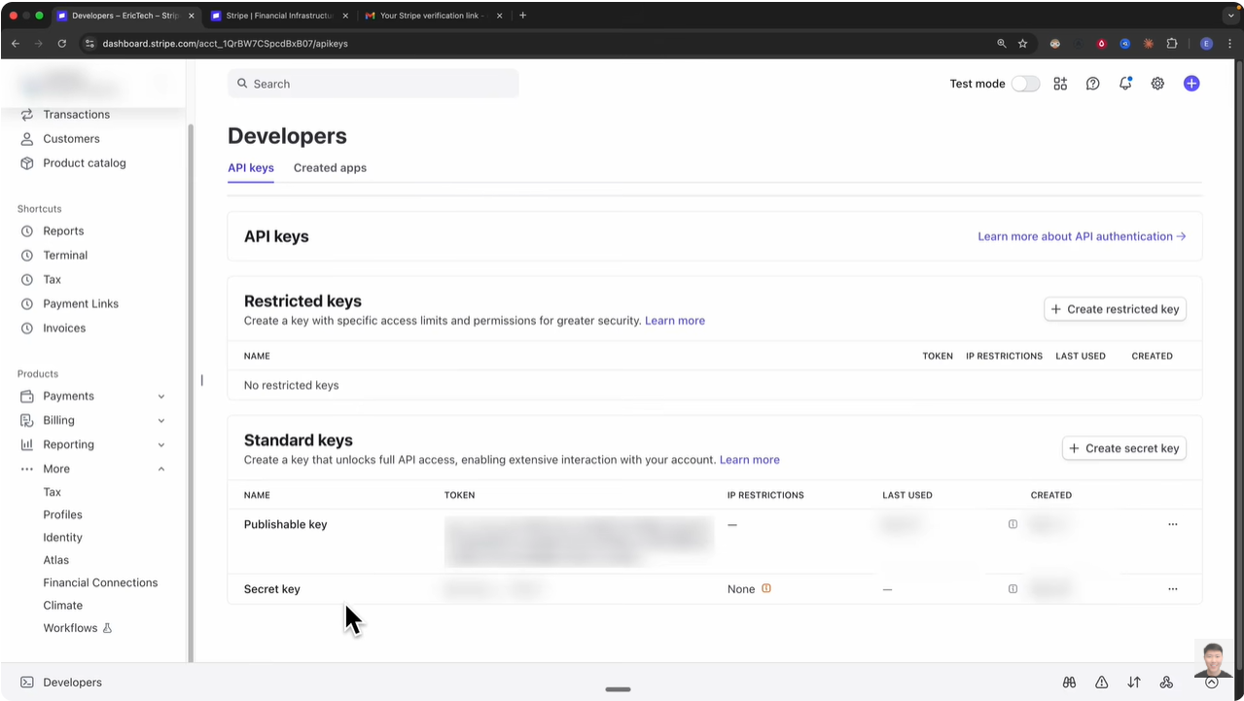

Slide 28
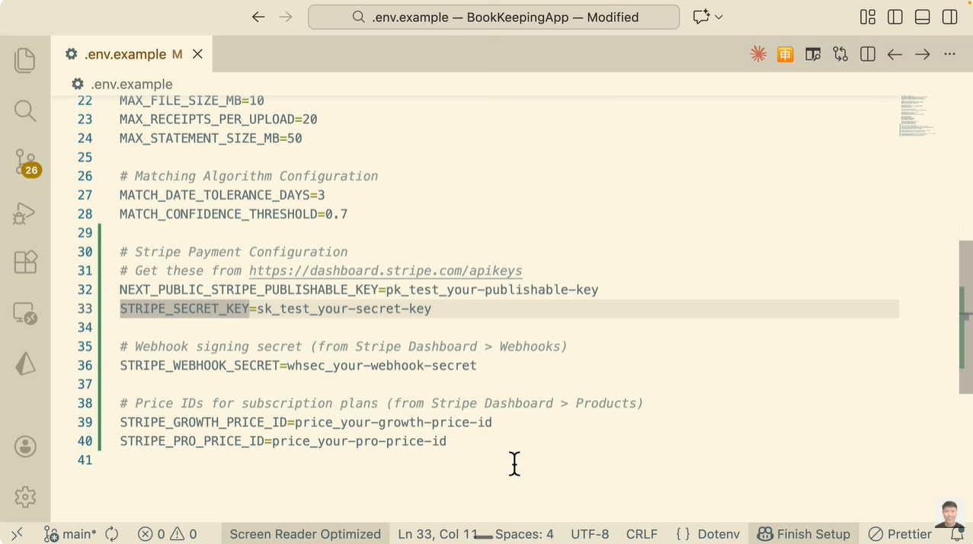

Slide 29
Eric discusses the final steps for completing a Stripe integration using Claude Code. He explains that after the AI has generated the necessary code and environment variables, you need to manually obtain specific API Keys from your Stripe Dashboard to make the payment system functional.
Where to find them: You need to navigate to the "Developers" section in your Stripe dashboard and then click on "API keys" [14:51].
The specific keys needed: He points out that you will need two main keys: the Publishable key and the Secret key [14:55].
Where to put them: These keys must be added to your project's .env.local file (specifically, Claude Code created variables like STRIPE_PUBLISHABLE_KEY and STRIPE_SECRET_KEY) [16:40].
Why they are necessary: These keys are what link your local application to your specific Stripe account, allowing the app to actually process payments or handle subscriptions [15:00].
Essentially, he is showing that while the AI can write all the integration logic, you still have to "plug in" your unique credentials from Stripe to take the application live or test it in a sandbox environment [17:19].

Slide 30
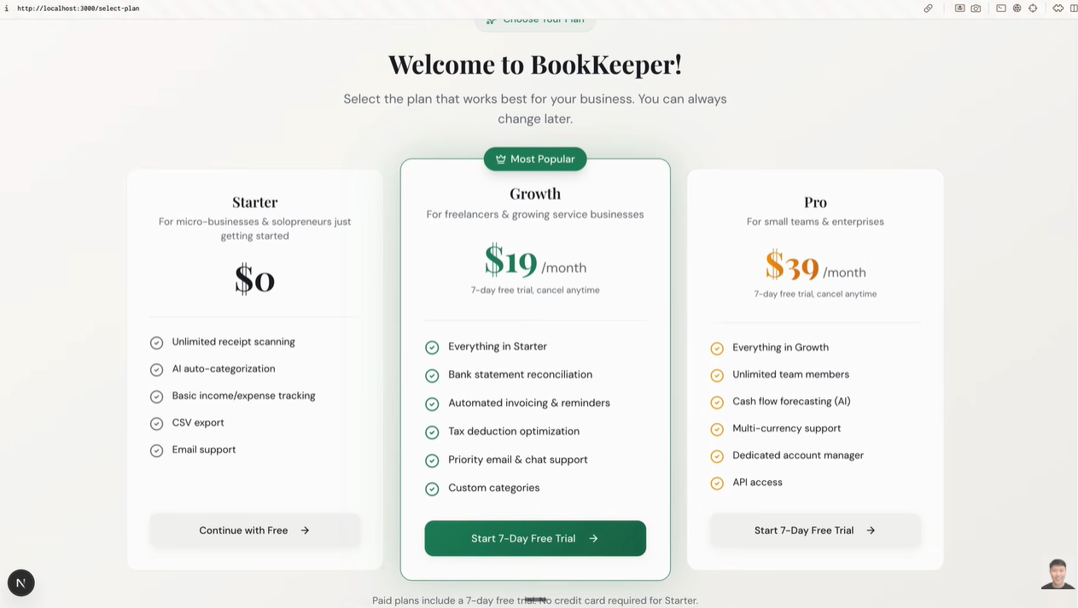

Slide 31
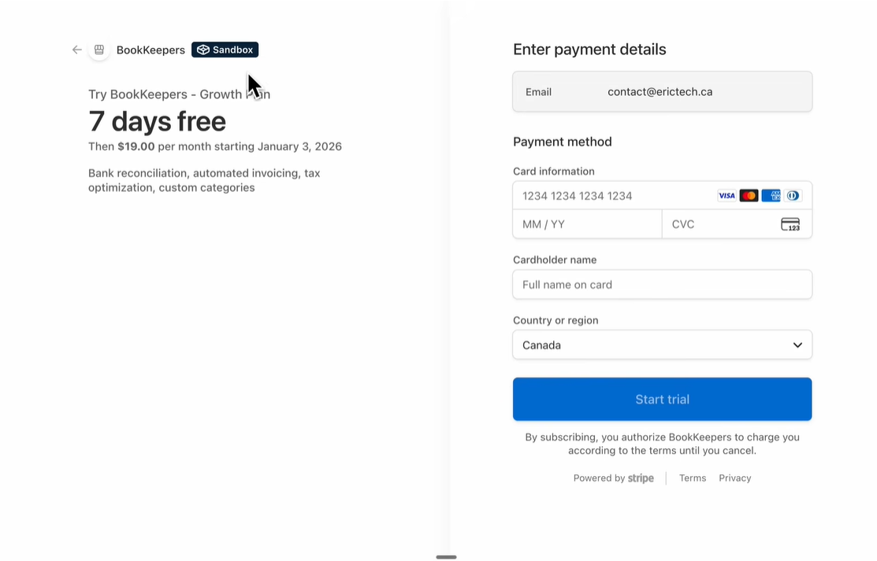

Slide 32
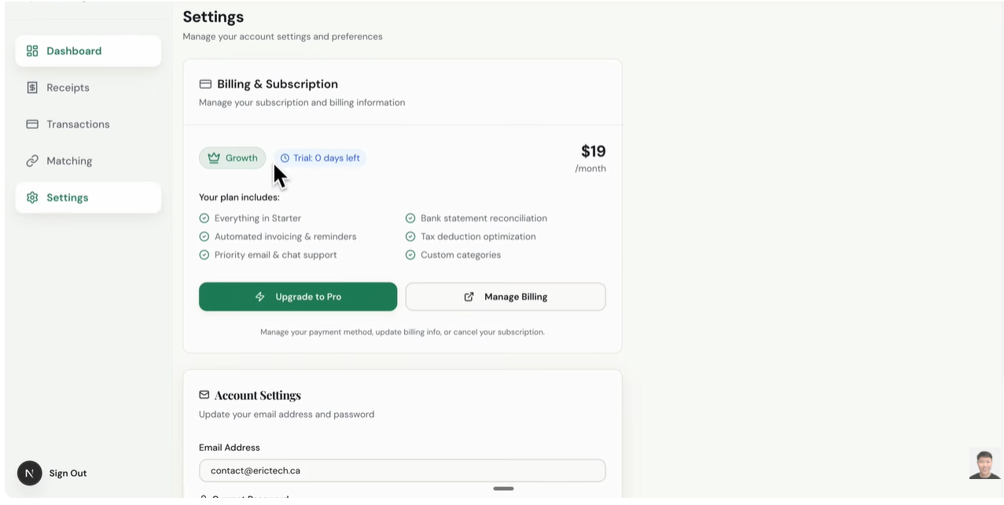

Slide 33
Skill Creator

Slide 34
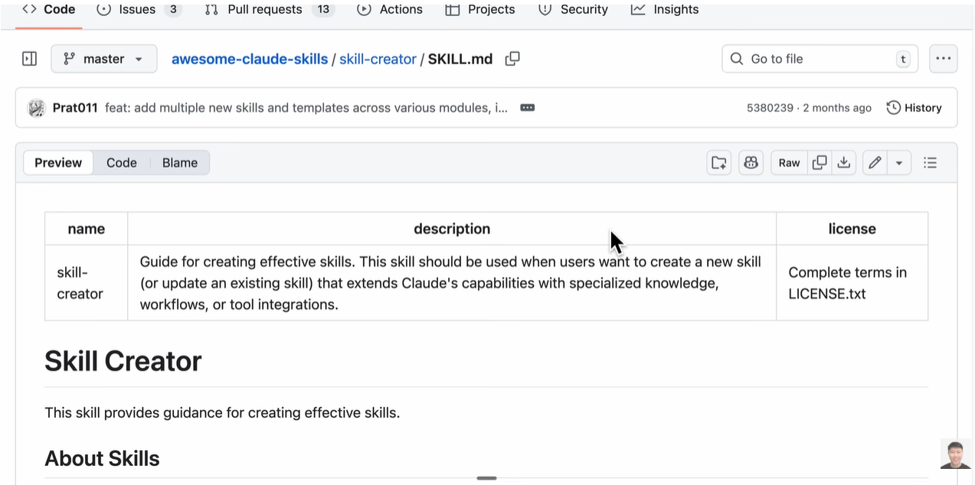

Slide 35
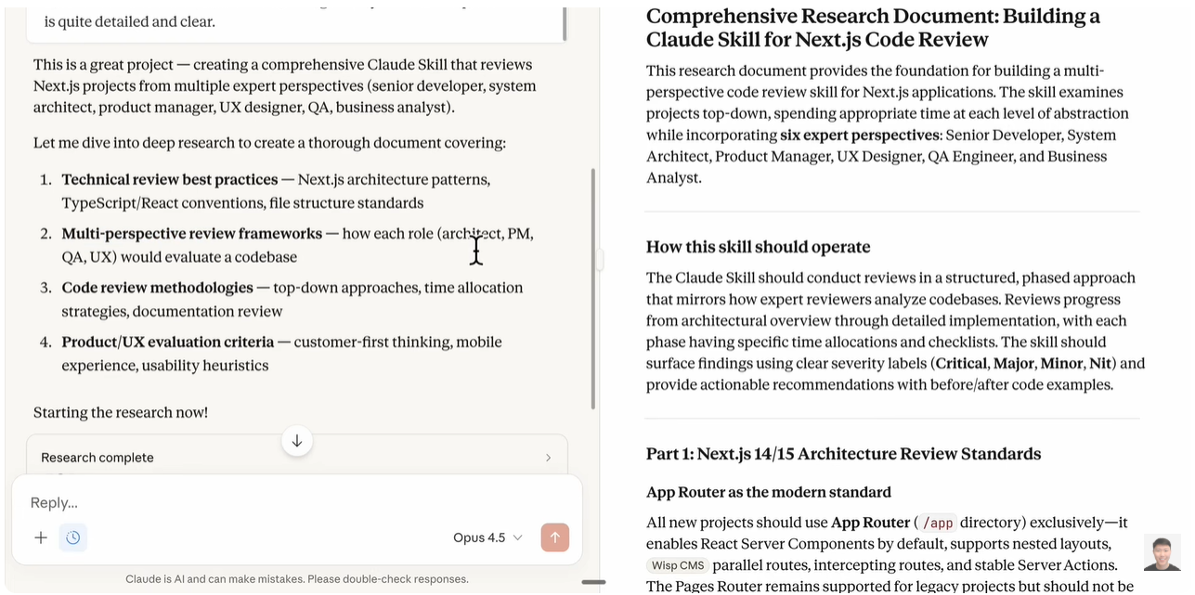

Slide 36
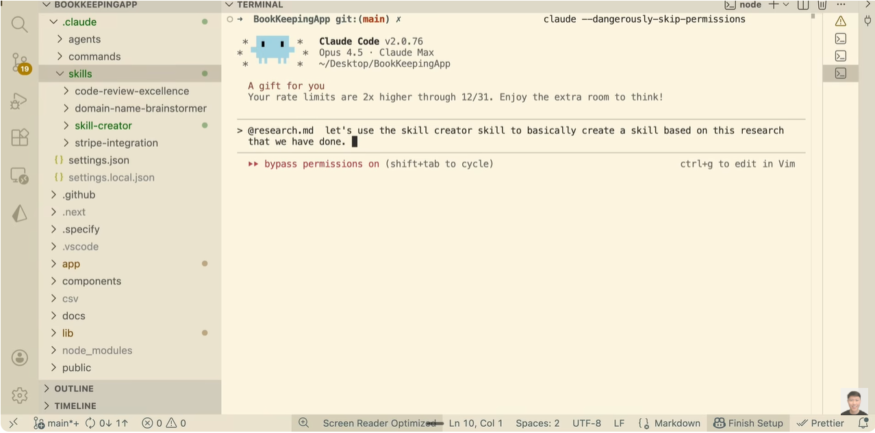

Slide 37
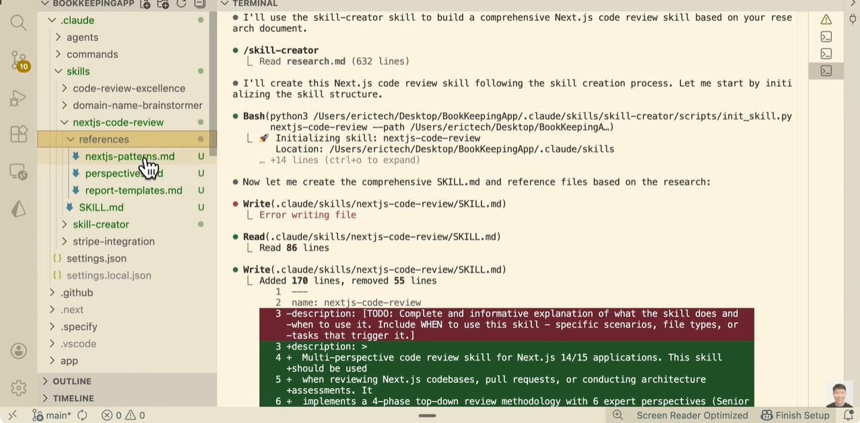

Slide 38
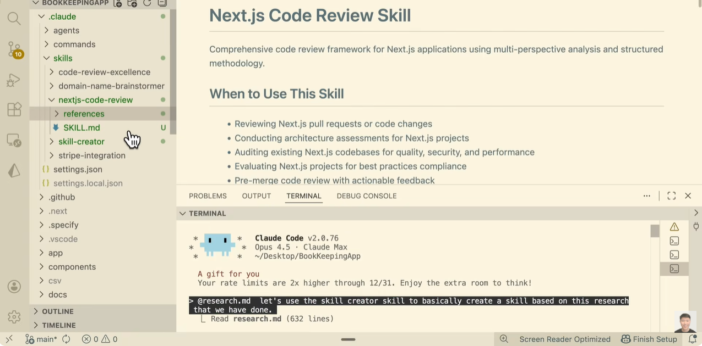

Slide 39
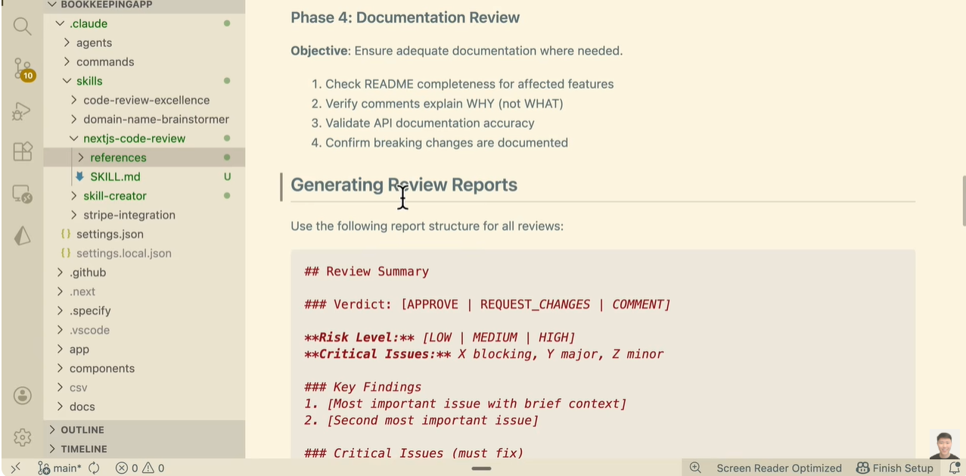

Slide 40
At around 21:36, you are correct that Eric opens a new session, but he does not switch to the Claude AI website. Instead, he opens a new terminal session of Claude Code directly within his code editor (VS Code) [21:34].
Vibe Coding in the Terminal: He was already using Claude Code (the CLI tool) in a terminal window at the bottom of his VS Code screen to create a new "Skill.“
Opening a New Session: Once the skill was created and saved in his project folder, he initiated a fresh Claude Code session by running the claude command again in his terminal [21:34].
Triggering the Skill: In this new session, he didn't need to go to a website; he simply typed a prompt asking Claude to "use the Next.JS code review skill" to review his codebase [21:36].
Because the terminal is integrated into VS Code, it looks like he is jumping between tools, but he is actually staying within the same development environment (vibe coding) using the Claude Code CLI to interact with the project files he just generated [21:45].

Slide 41
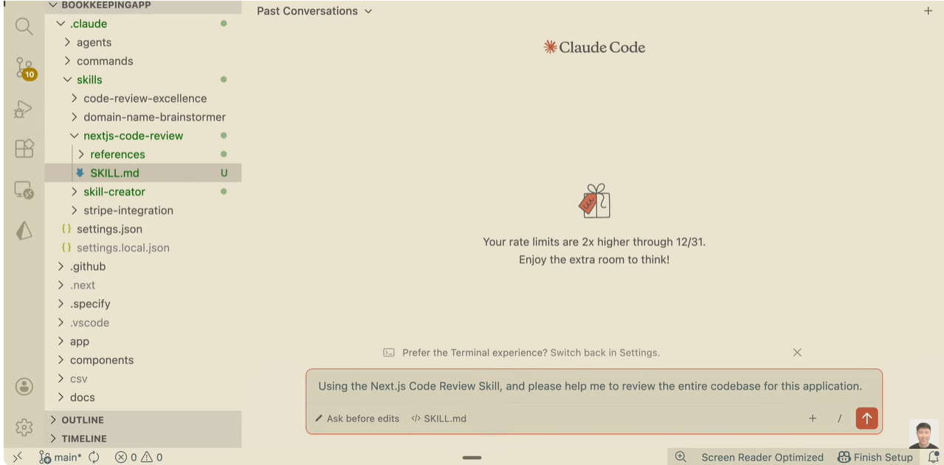

Slide 42
